Slide 1

The cravings project
Linea Fuller, Christine Li, Bryan Carro, Ramon Faylona, Christine Newkirk

Slide 2
Project Objective
To help satisfy specific or unspecific hunger, this project, aims to quickly sate it. Through the means of recommended local heats maps, to reviews and customizable search dashboard for people’s go-to spots in Oregon.
A customizable dashboard combined with a heatmap to be designed and created to help find and satisfy a particular carvings from something specific to something obscure.

Slide 3
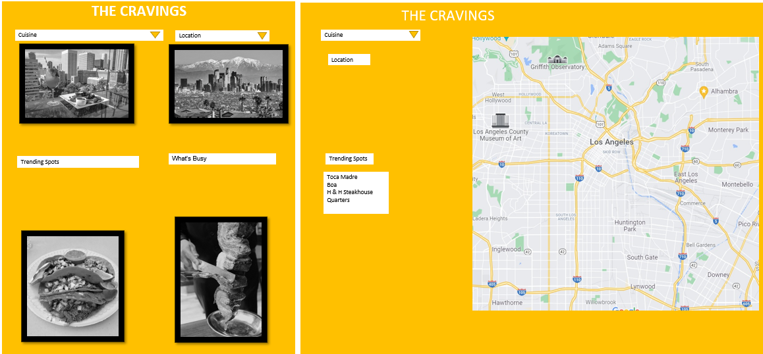
Website Theme and layout

Slide 4
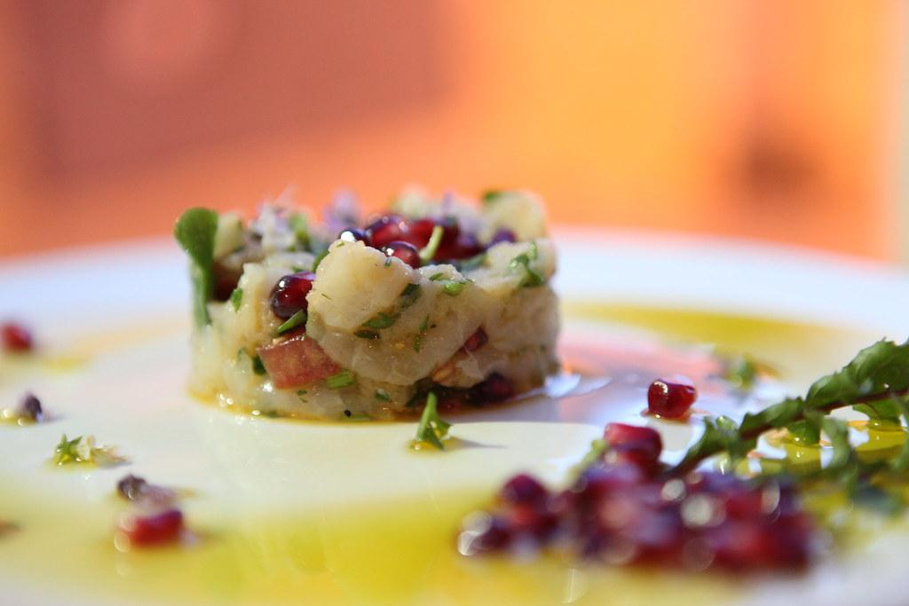
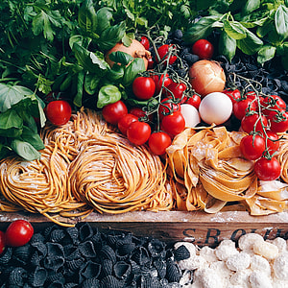
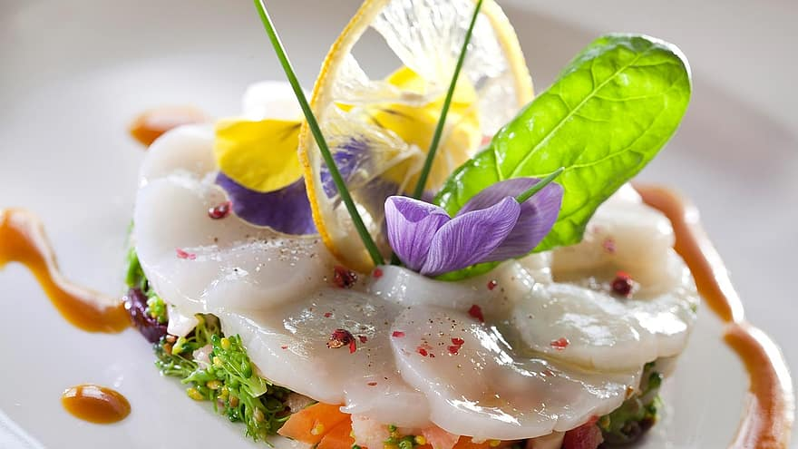
Data Sources
Three Datasets from Yelp
Yelp_academic_dataset_business.json
-includes restaurant geodata (business id, city, state, hours, address, longitude, latitude, stars, review counts, etc.)
Yelp_academic_dataset_checkin.json
-includes business id and all check-in dates
Yelp_academic_dataset_tip.json
-includes business id and business reviews

Slide 5
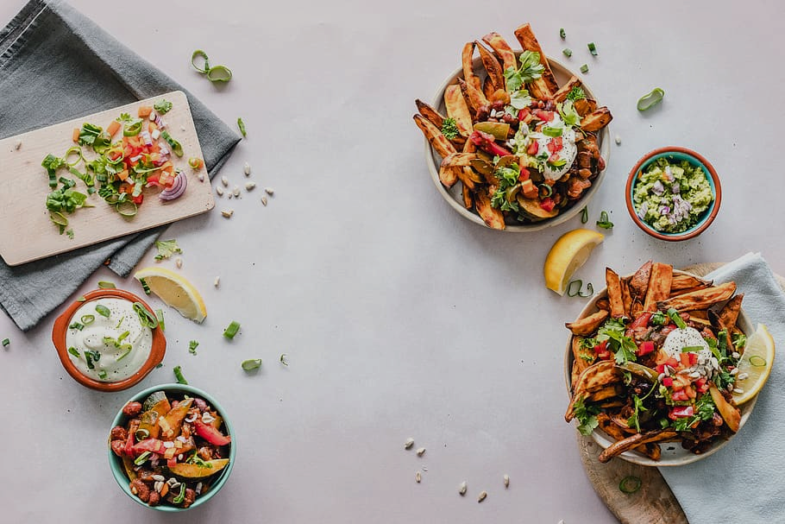
Coding Approach
Cleaning & Merging the Data
Built-up of the Frontend of the website
Further build-up of the website backend with data connection
Data Visualization

Slide 6

Data Cleaning &
Merging
Notes:
please mention Enrollment csv (from CA State GeoPortal), COVID csv (from CA Open Source), Gmaps API

Slide 7
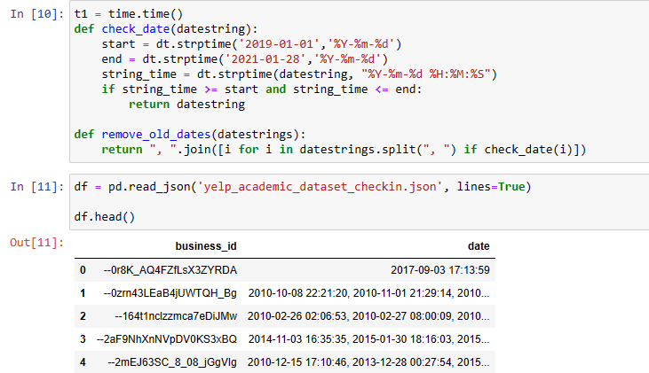
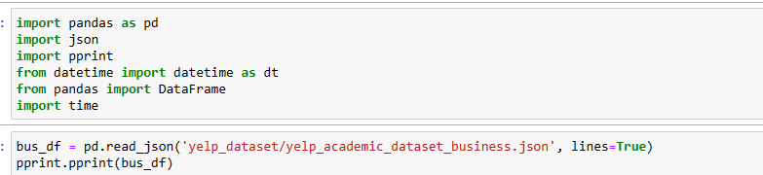
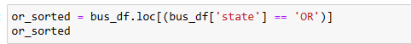

Cleaning yelp datasets

Slide 8
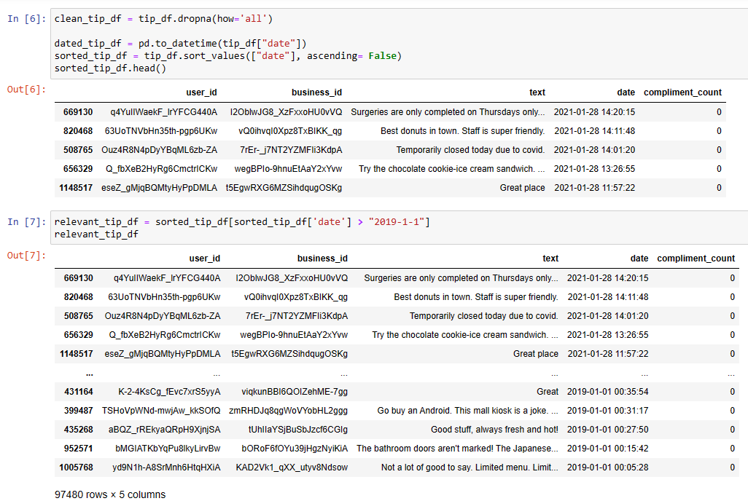
Cleaning yelp datasets

Slide 9


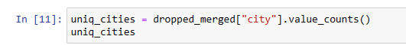


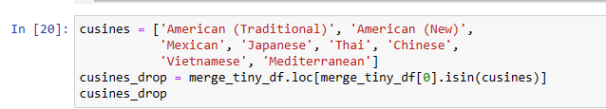

Merging Yelp Datasets

Slide 10
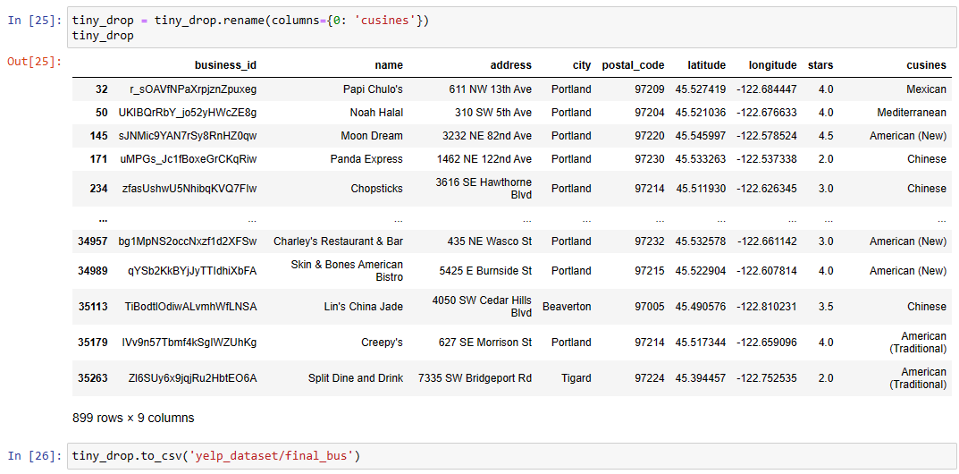
Merging yelp datasets

Slide 11
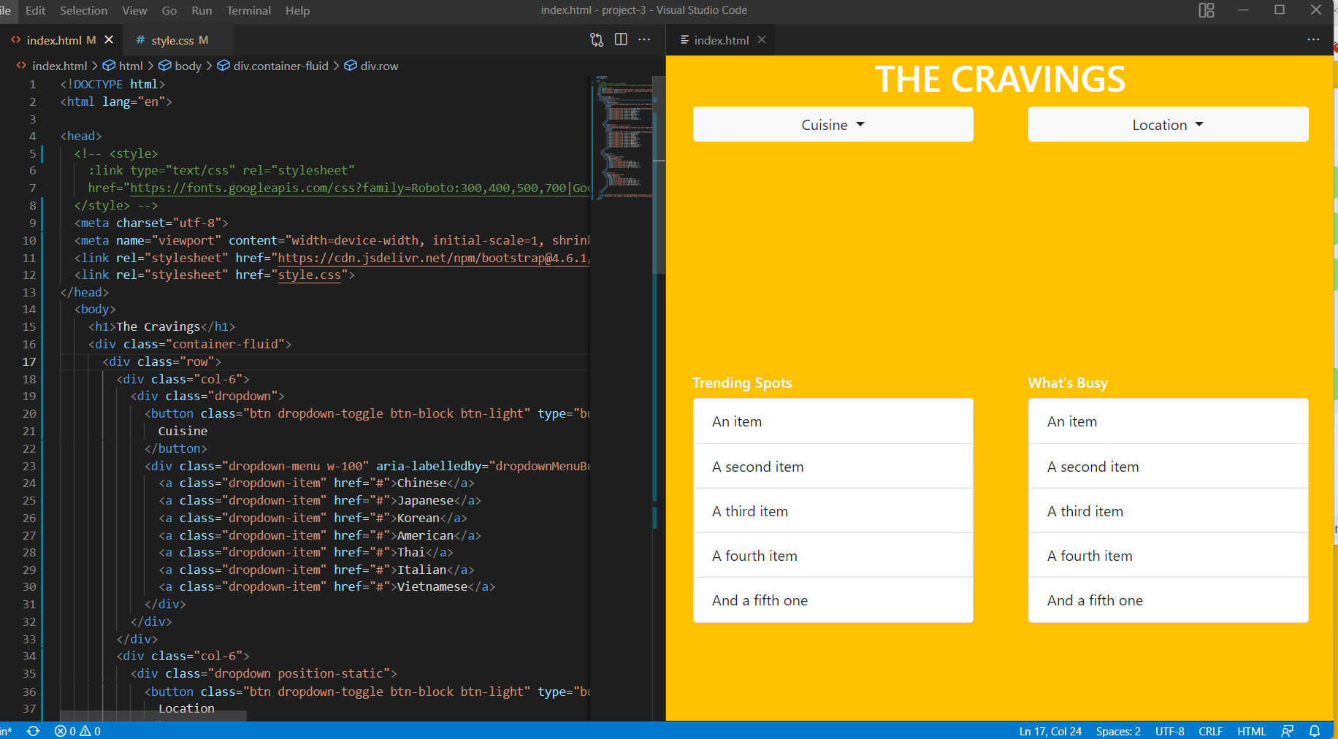
Built-up of Website Frontend

